Slide 1
Lecture 12: Objects, Lists, Sequences (Part II)
Understand the memory use with lists, lists of objects, list slices and list expressions
Kok-Seng Wong | 2021

Slide 2
Lists - review

Slide 3

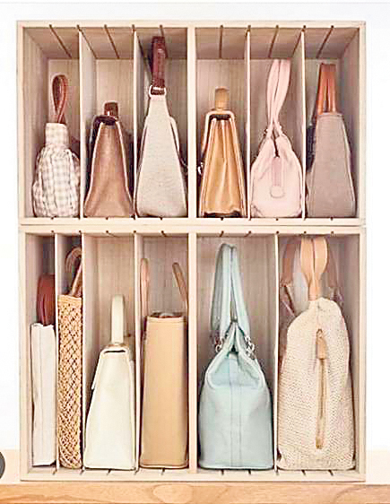
Motivation example
[source]
[source]

Slide 4
Learning outcomes
Upon the completion of this lecture, students will be able to:
understand memory use with list in Python.
understand and apply nested list method.
use enumerate to keep track of index and element values.
make a list comprehension in Python.

Slide 5
Class practice (review)
>>> p = [2, 4, 6]
>>> p += [10]
>>> p
>>> q = [1, 3, 5]
>>> q += 9
>>> q

Slide 6
Class practice (review)
>>> list1 = list(range(10))
>>> list1
>>> list2 = list(range(3,15))
>>> list2
>>> list3 = list(range(10,-1,-1))
>>> list3
>>> list4 = list(range(0,100,20))
>>> list4

Slide 7
Lists representation
Global Space
x = [4, -5, 3, 2]
x | 4 | -5 | 3 | 2
Correct:
Wrong:
Global Space
Heap Space
id1
 |  | list
0 | 4
1 | -5
2 | 3
3 | 2
x | id1

Slide 8
objects
Python supports different kinds of data:
Each object has the following properties:
A type
An internal data representation
A set of procedures for interaction with the object
An object is an instance of a type
object:
"abc" 3.14159 [1, 3, 5] 223
type:
string float list int

Slide 9
Comparing two lists
== operator compares the values of two objects
Global Space
a | id1
b | id2
c | id3
>>> a = [1, 2, 3, 4]
>>> b = [3, 4, 5, 6, 9]
>>> c = [1, 2, 3, 4]
>>> a == c
True
>>> a == b
False
Heap Space
id2
 |  | list
0 | 3
1 | 4
2 | 5
3 | 6
4 | 9
id1
 |  | list
0 | 1
1 | 2
2 | 3
3 | 4
id3
 |  | list
0 | 1
1 | 2
2 | 3
3 | 4
equality operator (==) compares the values of both the operands and checks for value equality.
'is' operator checks whether both the operands refer to the same object or not (check if they are in the same memory location)

Slide 10
Aliasing lists
Heap Space
id1
 |  | list
0 | 11
1 | 22
2 | 33
3 | 44
list_1 and list_2 are variables that refer to the same list object.
The object is aliased because it has more than one name.
>>> list_1 = [11, 22, 33, 44]
>>> list_2 = list_1
>>> list_2
[11, 22, 33, 44]
Global Space
list_1 | id1
list_2 | id1

Slide 11
The is operator
is operator: compares the identity of two objects
>>> list_1 = [11, 22, 33, 44]
>>> list_2 = list_1
>>> list_1 is list_2
True
>>> list_2
[11, 22, 33, 44]
>>> list_2 = [55, 66]
>>> list_3 = [55, 66]
>>> list_2 is list_3
False
list_1 and list_2 refer to the same object
list_1 and list_3 have the same elements BUT refer to different objects

Slide 12
Class practice
my_enemy = ["Wilson", "Iris", "Andrew", "JaWee"]
my_friend = ["Wilson", "Iris", "Andrew", "JaWee"]
my_enemy[1] = "Park"
>>> my_enemy is my_friend
>>> my_enemy
>>> my_friend
false
['Wilson', 'Park', 'Andrew', 'JaWee']
['Wilson’, Iris', 'Andrew', 'JaWee']
Reassigning an element of my_enemy does not affect my_friend!

Slide 13
Copying a list
list(): makes a copy of a list
>>> alphabets = ["t", "w", "h", "k"]
>>> alphabets_copy = list(alphabets)
>>> alphabets_copy
['t', 'w', 'h', 'k']
>>> alphabets_copy is alphabets
False

Slide 14
Extend a list
extend(): adds a sequence of elements to the end of a list
>>> SEA_country = ["Thailand", "Vietnam", "Malaysia"]
>>> SWA_country = ["Yemen", "Saudi Arabia", "Kuwait", "Qatar"]
>>> SEA_country.extend(SWA_country)
>>> SEA_country
['Thailand', 'Vietnam', 'Malaysia', 'Yemen', 'Saudi Arabia', 'Kuwait', 'Qatar']
Same as: SEA_country + SWA_country

Slide 15
Class practice
>>> language = ["Java", "Python", "C++"]
>>> new_language = ["Pascal", "VB"]
>>> ?
>>> language
['Java', 'Python', 'Pascal', 'VB', 'C++']

Slide 16
Class practice
>>> x = ["t", "w", "h", "k"]
>>> y = x[1:3]
>>> z = y.sort()
>>> y
>>> z
[demo]

Slide 17
Nested list
A nested list: a list contains another list (sub-list)
nested_list = ["a", ["b", ["c", "d"], "e", "f"], "g"]
Nested_list
a |  | g
0 | 1 | 2
Nested_list[1]
b |  | e | f
0 | 1 | 2 | 3
Nested_list[1][1]
c | d
0 | 1

Slide 18
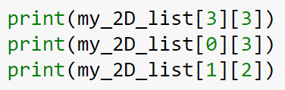
2-Dimensional lists
column
 | 0 | 1 | 2 | 3
0 | a | b | c | d
1 | e | f | g | h
2 | i | j | k | l
3 | m | n | o | p
4 | q | r | s | t
my_2D_list = [
["a", "b", "c", "d"],
["e", "f", "g", "h"],
["i", "j", "k", "l"],
["m", "n", "o", "p"],
["q", "r", "s", "t"]
]
row

Slide 19
Class practice
>>> animal = ["pig", "dog", "dragon", "hello kitty"]
>>> animal.append(["spiderman", "batman"])
>>> print(len(animal), animal[4])
How can you “catch” the batman?

Slide 20
class practice
X = [1, 2, [33, 44,
[555, 666]], 7, 8]
print(X[3])
print(X[2])
print(X[2][2])
print(X[2][2][0])
Print(X[-2])
print(X[-3][-1][-2])

Slide 21
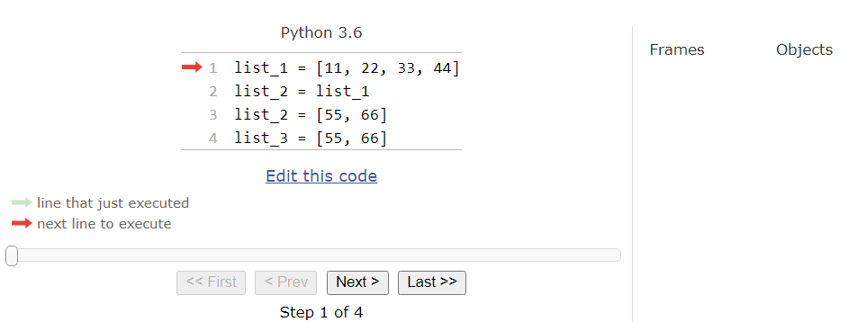
Visualization – python tutor
[demo]

Slide 22
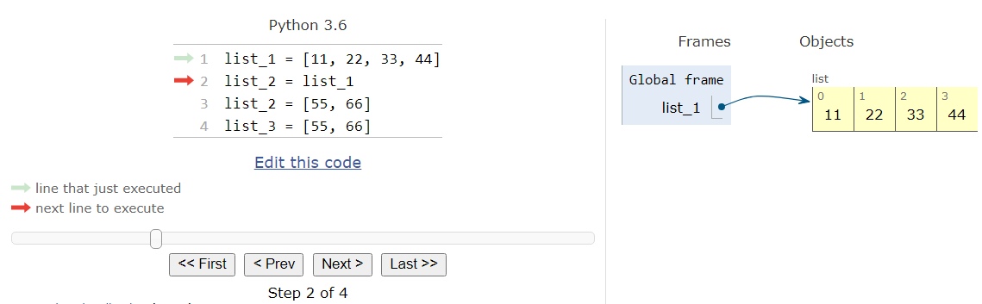
Visualization – python tutor

Slide 23
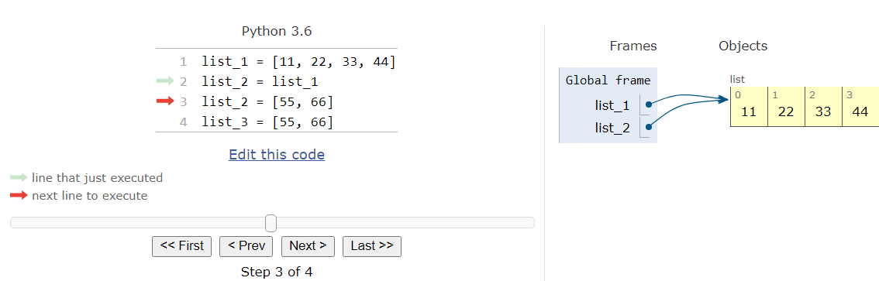
Visualization – python tutor

Slide 24
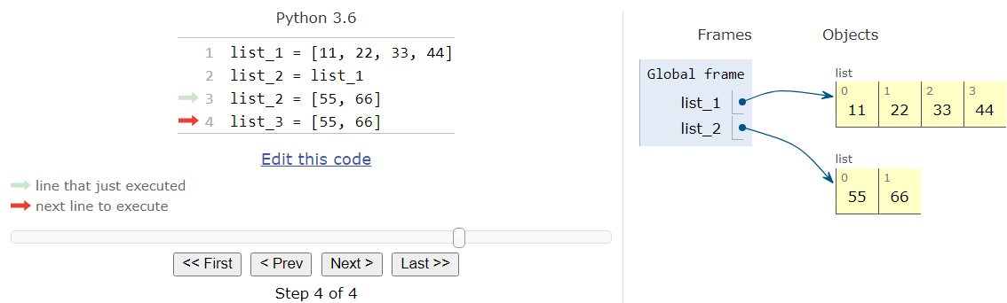
Visualization – python tutor

Slide 25
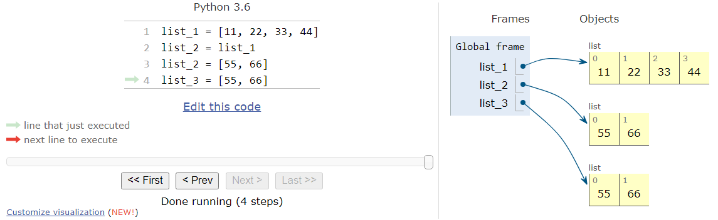
Visualization – python tutor

Slide 26
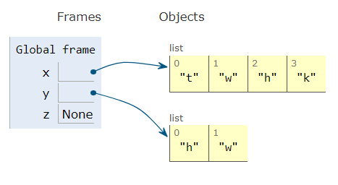
List slices – Example 1
Slices will create new objects
x = ["t", "w", "h", "k"]
y = x[1:3]
z = y.sort()
[Demo]

Slide 27
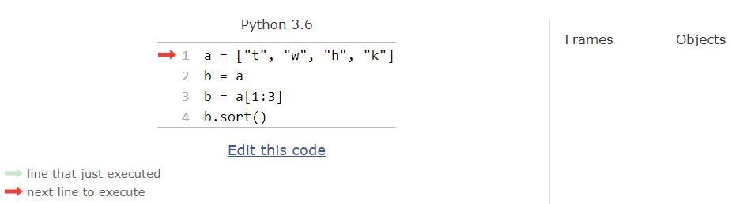
List slices – Example 2
a = ["t", "w", "h", "k"]
b = a
b = a[1:3]
b.sort()
[Demo]

Slide 28
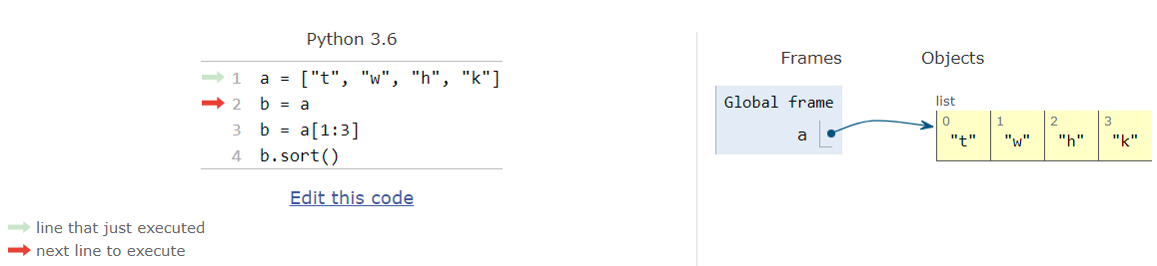
List slices – Example 2

Slide 29
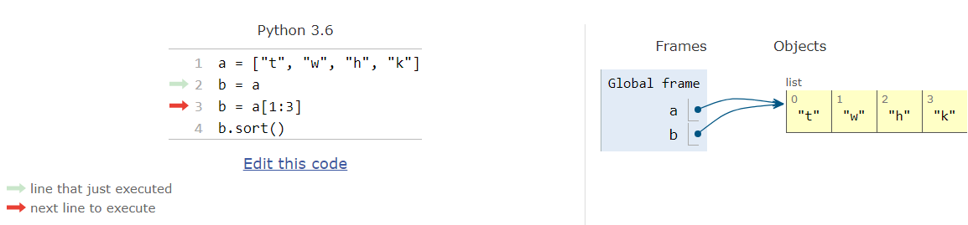
List slices – Example 2

Slide 30
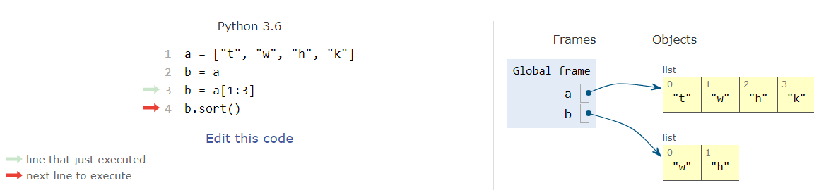
List slices – Example 2

Slide 31
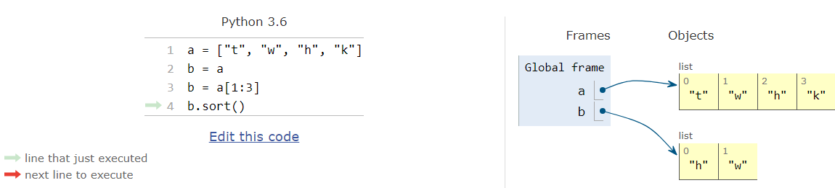
List slices – Example 2

Slide 32
Enumerate()
Use enumerate to keep track of index and element values: adds a counter to an iterable and returns it in a form of enumerate object.
The enumerate() takes two parameters:
iterable - a sequence, an iterator, or objects that supports iteration
start (begin) - starts counting from begin number. By default, enumerate()starts with 0 if start parameter is omitted.

Slide 33
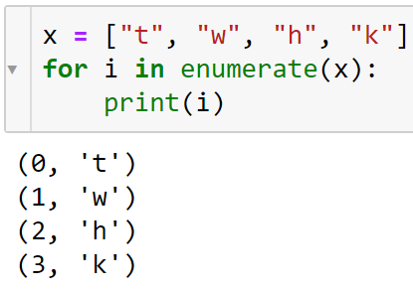
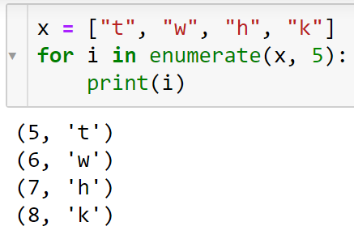
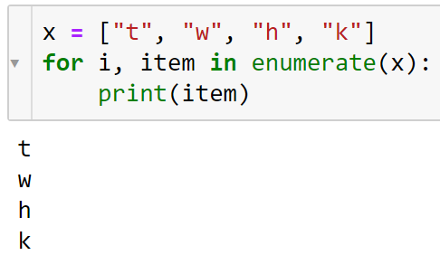
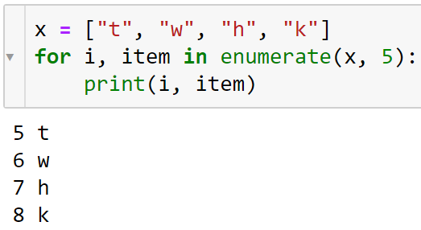
Enumerate() example
start is set to 5
By default start is set to 0

Slide 34
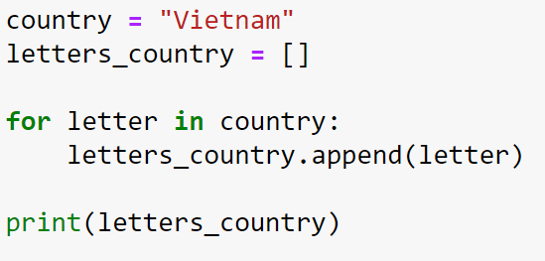
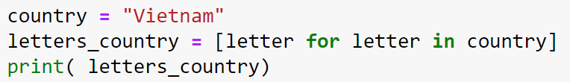
List comprehension
Iterating through a string with for-loop
Iterating through a string with list comprehension method

